Slide 1


Department of Information Technology
Velagapudi Ramakrishna Siddhartha Engineering College
Hospital Management System Using MERN
MERN Stack Web Development
B.Tech in Information Technology
INDUSTRIAL – RESEARCH INTERNSHIP 23-24 Review Presentation
Presented by
Devi Divya Sri Perni (208W1A12A9)
Rishitha Polavarapu (208W1A12B0)
Guna Sri Manjunath (208W1A12B1)
Under the guidance of
Mr. N Ravi Siva Ram Teja – Full Stack Developer, Codegnan IT Solutions Pvt Ltd.

Slide 2
AGENDA
Problem Statement
Abstract
Architecture Diagram
Requirements
Implementation
Certificate

Slide 3
PROBLEM STATEMENT
Hospitals struggle with managing patient data, resource allocation, and appointment scheduling, leading to inefficiencies, delays, and errors in patient care.
Current systems often lack real-time visibility into critical patient information, leading to slower decision-making and resource misallocation
Our project, the "Medi track: Hospital Management System using MERN" ,where you can have many services.

Slide 4
ABSTRACT
In a healthcare landscape marked by operational inefficiencies and data fragmentation, the "Meditrack: Hospital Management System using MERN" project seeks to revolutionize hospital management. The system aims to resolve issues related to inefficient patient management, real-time data accessibility, and financial inefficiencies by leveraging the power of the MERN stack (MongoDB, Express.js, React, and Node.js). With features such as streamlined patient registration, optimized resource allocation, automated appointment scheduling, centralized data accessibility, and error-free billing processes, Meditrack promises to improve patient care, enhance operational efficiency, and boost financial stability for healthcare institutions, ultimately ushering in a new era of effective and responsive hospital management.

Slide 5
ARCHITECTURE DIAGRAM
Front End
Middle End
Back End
User interface
Node.js
Mongo db
Model
Express.js

Slide 6
REQUIREMENTS
Software requirements of the project are as follows
Windows 7 to 11
Node JS , Npm should be installed in the system.
Vs code editor
Technology used: React JS , Express JS & Node JS Frameworks, Mongo DB Atlas.

Slide 7
IMPLEMANTION
Create a new project directory and Set up the development environment by installing Node.js, MongoDB
A MongoDB database schema is designed to store and manage user data, users questions, and answers to the particular questions. Implement the backend using Node.js and Express.
The client-side is built using React for the user interface. The UI/UX is designed to provide a user-friendly and engaging experience.
Thoroughly test the application by simulating various user scenarios, like user registration, login, asking questions, answering questions and searching particular questions in real-time.
Deployment on popular hosting platforms like AWS or render will enable widespread accessibility.

Slide 8
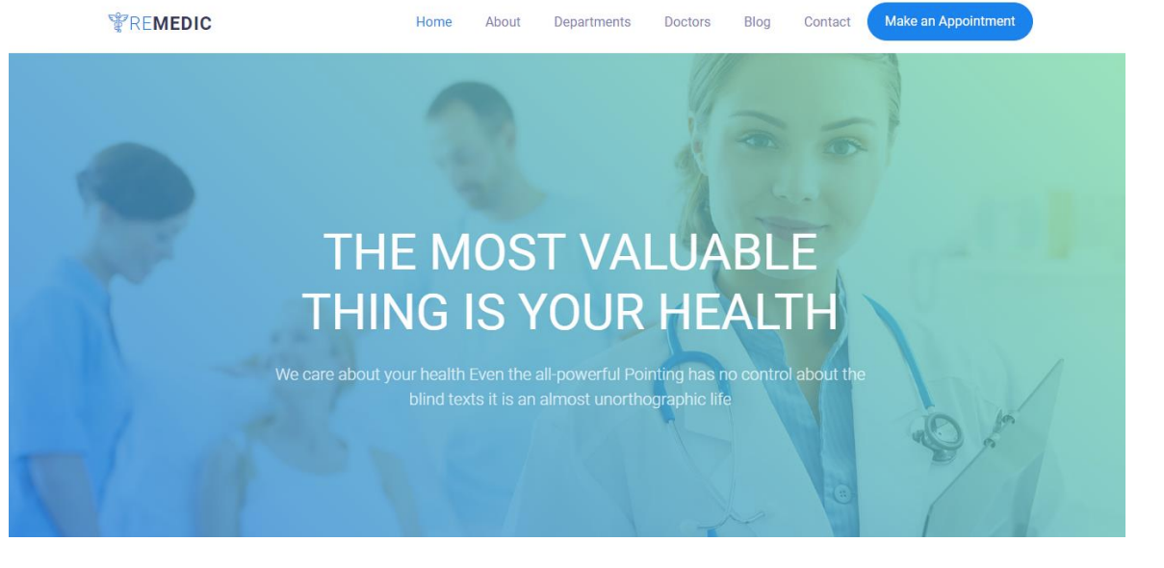
RESULTS
Once we give the npm start command to the command prompt in the both front end back-end then the application starts and displays
Home Page

Slide 9
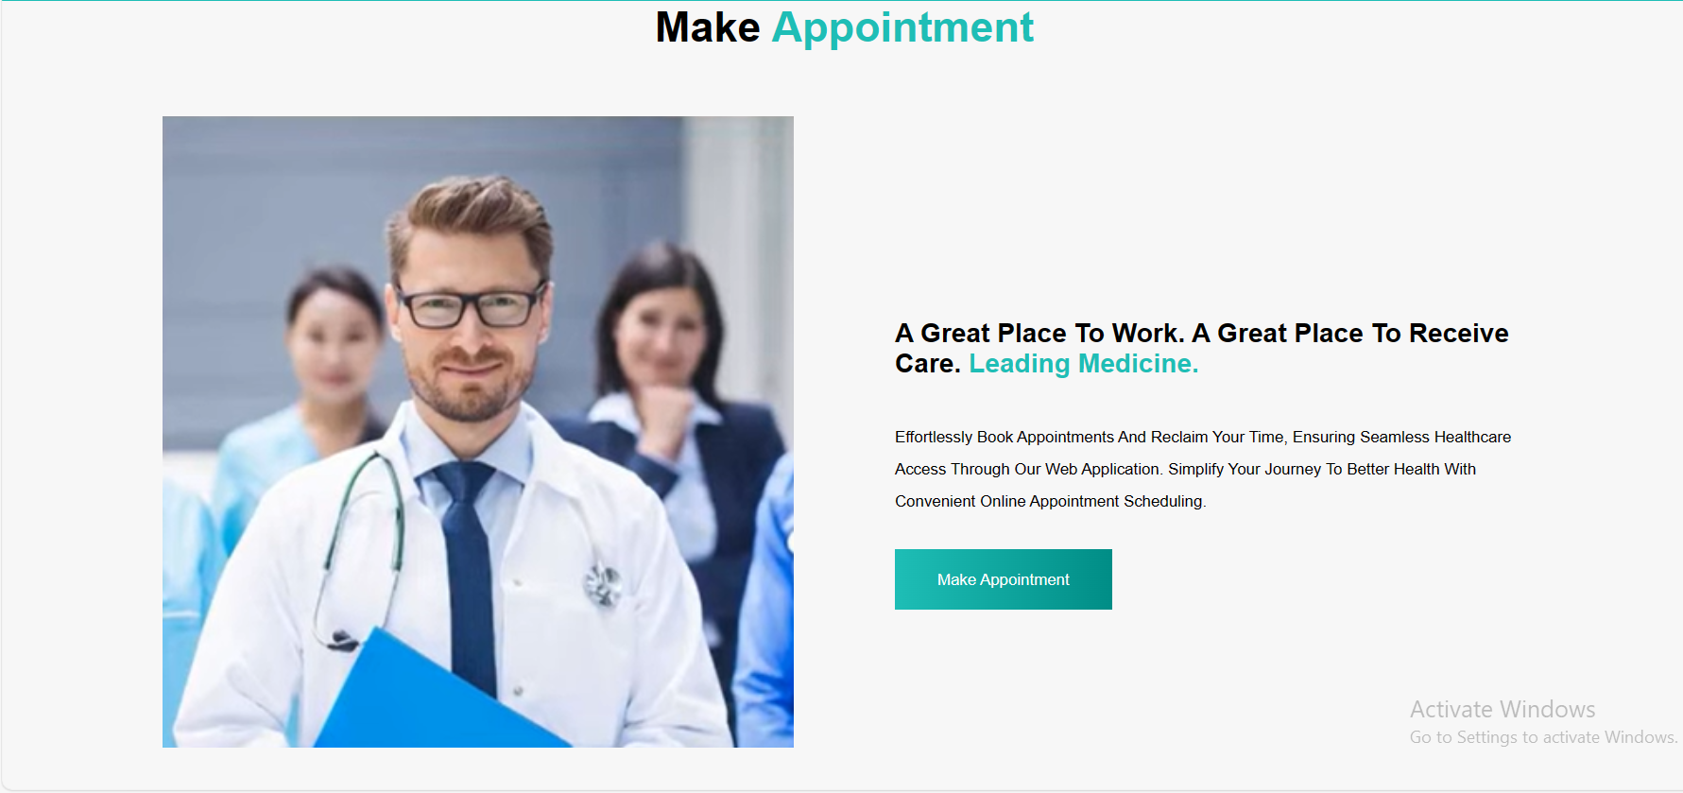
Appointment Page

Slide 10
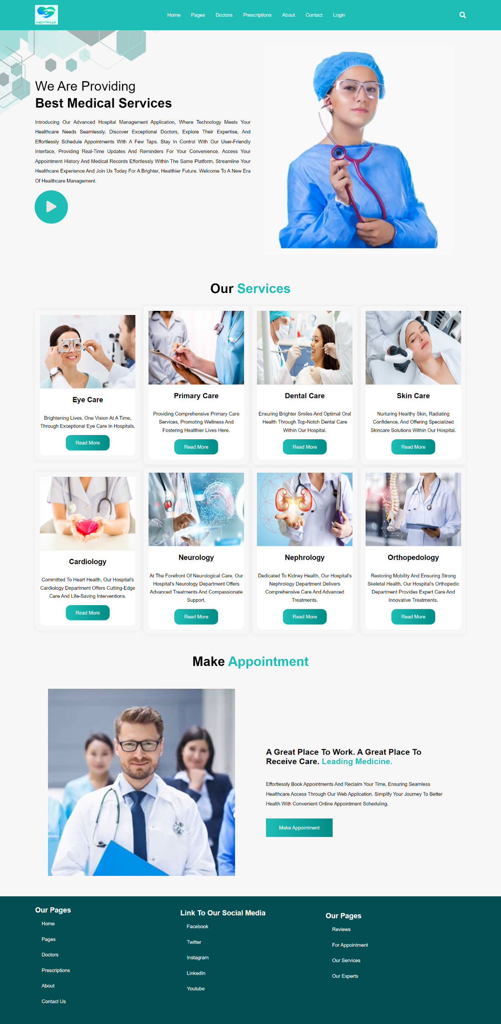
Blog

Slide 11

About Us

Slide 12
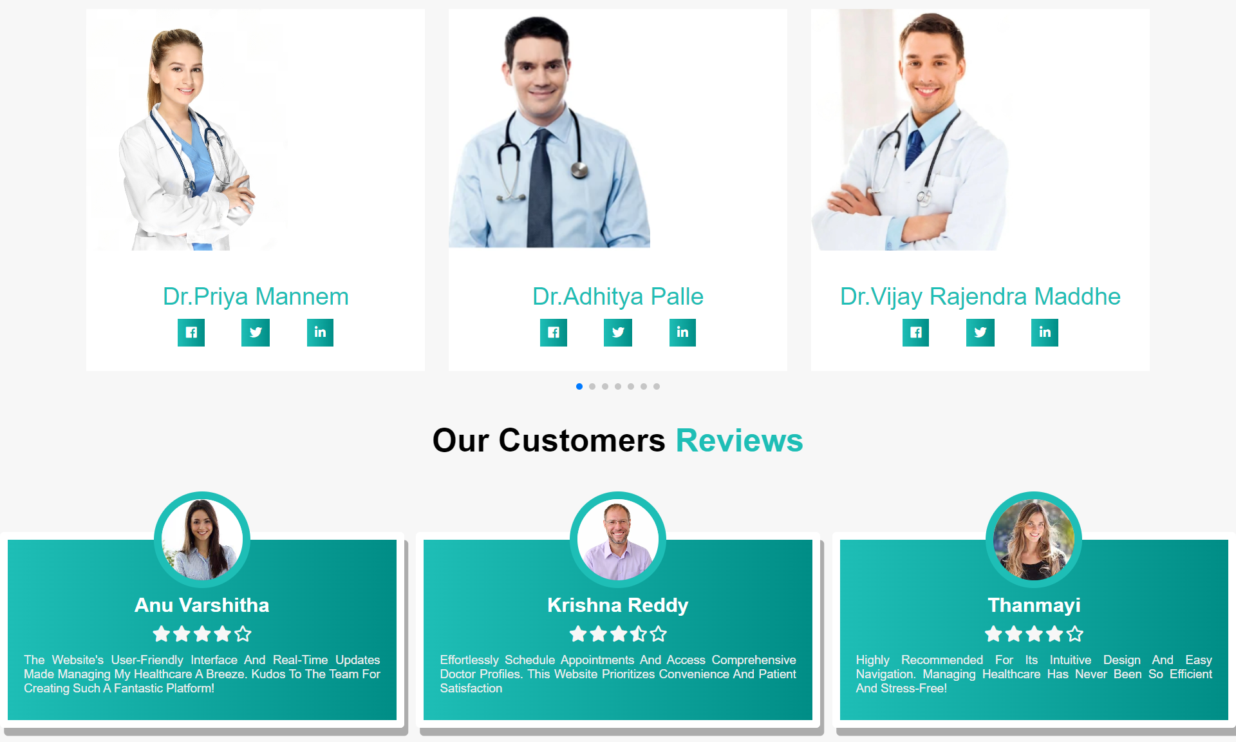
Doctors

Slide 13
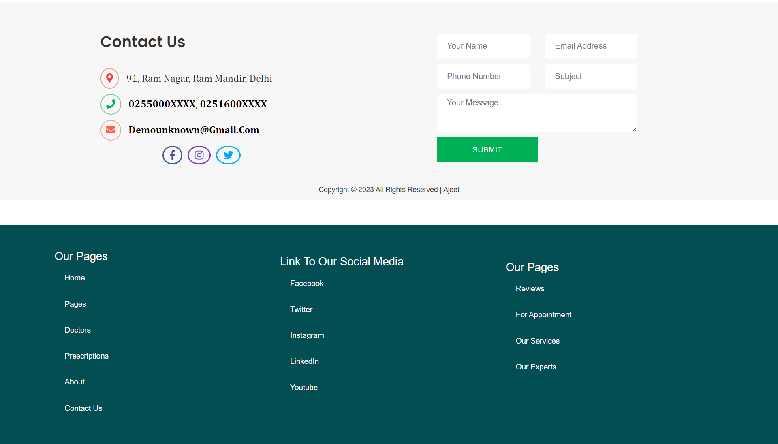
Contact Us

Slide 14
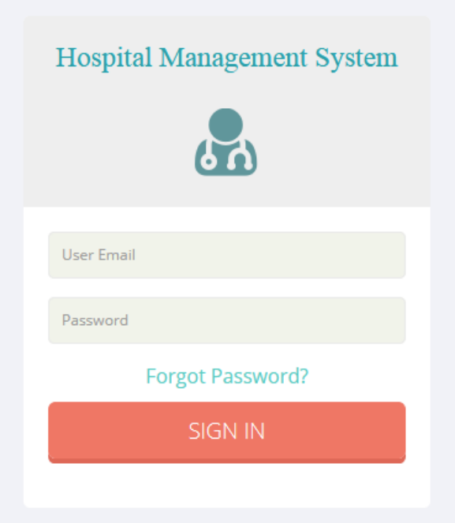
Login

Slide 15
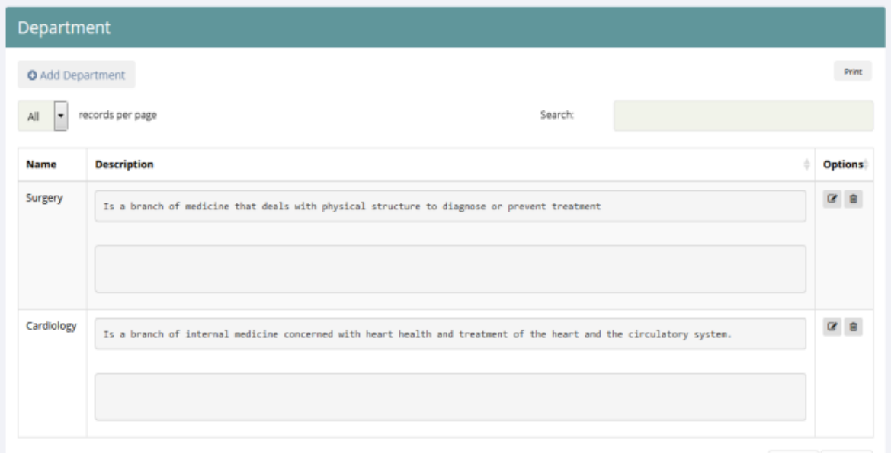
Department Page

Slide 16
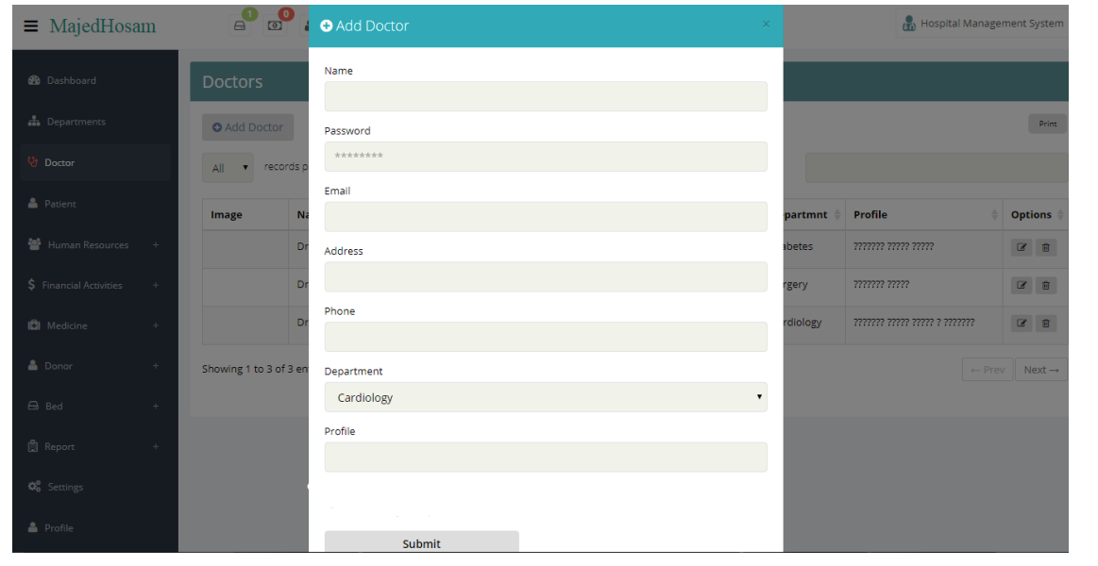
Registration

Slide 17
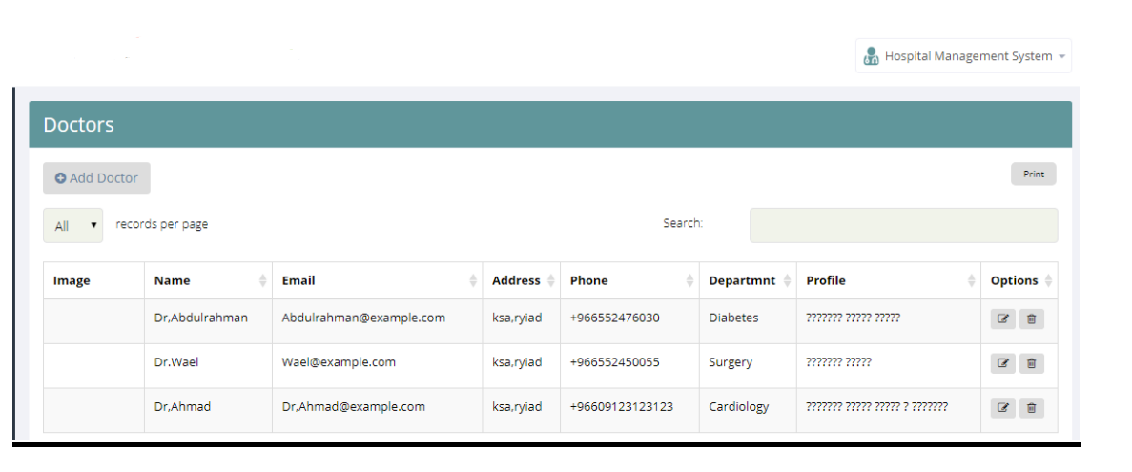
Doctors Panel

Slide 18
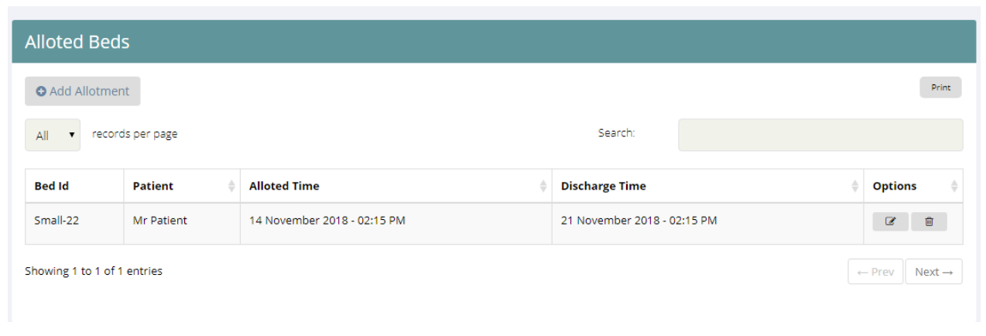
Allotted beds

Slide 19
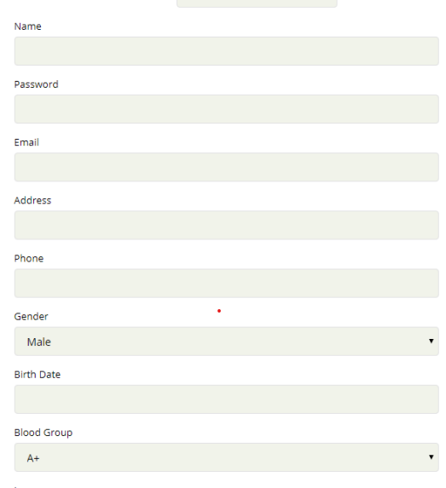
Patient Operation

Slide 20
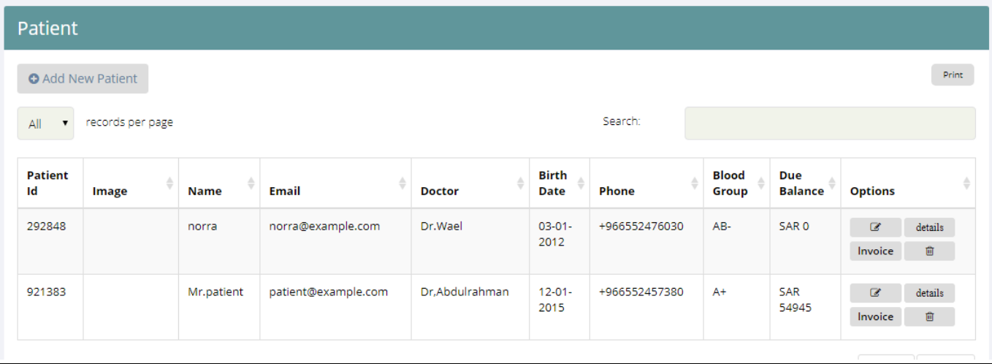
Patient Page

Slide 21
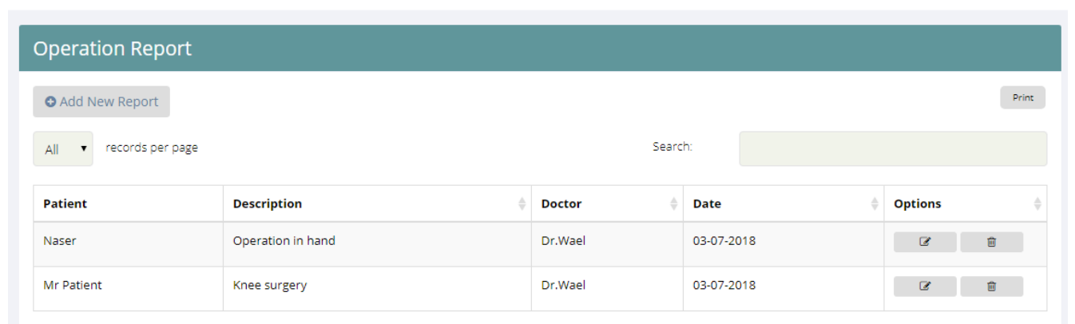
Operation Report

Slide 22
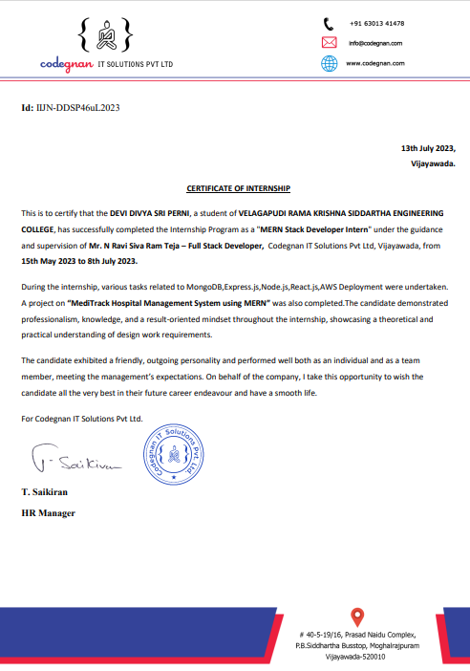

Slide 23
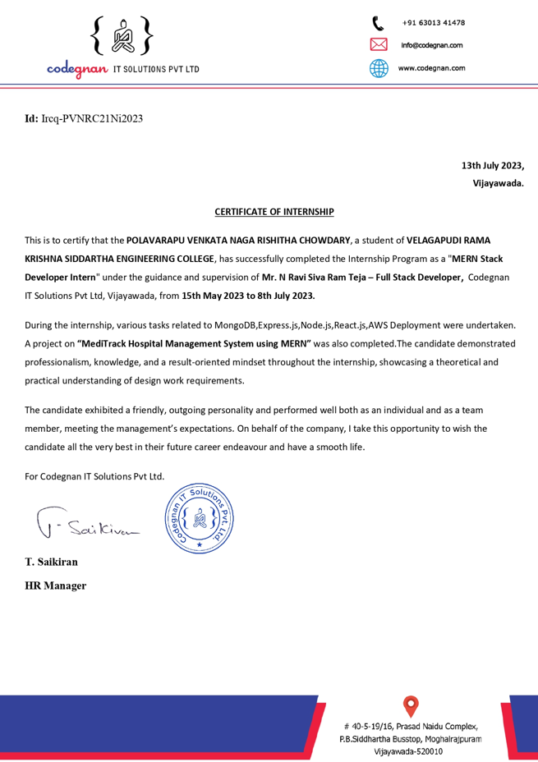

Slide 24
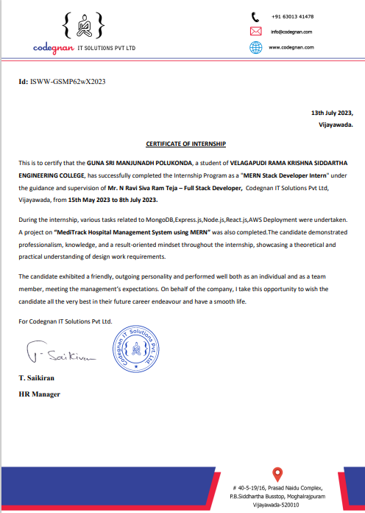

Slide 25
THANK YOU

